Slide 1
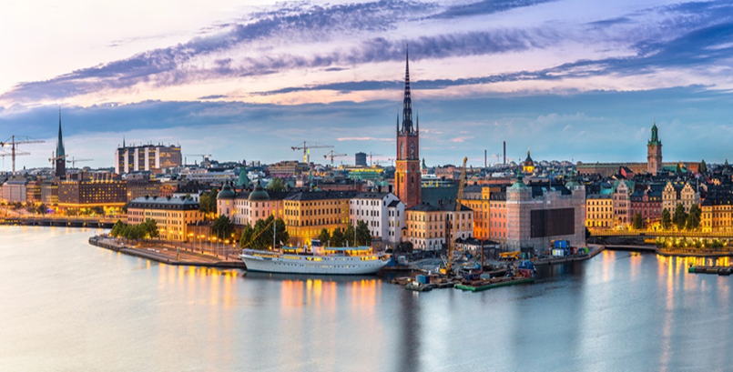
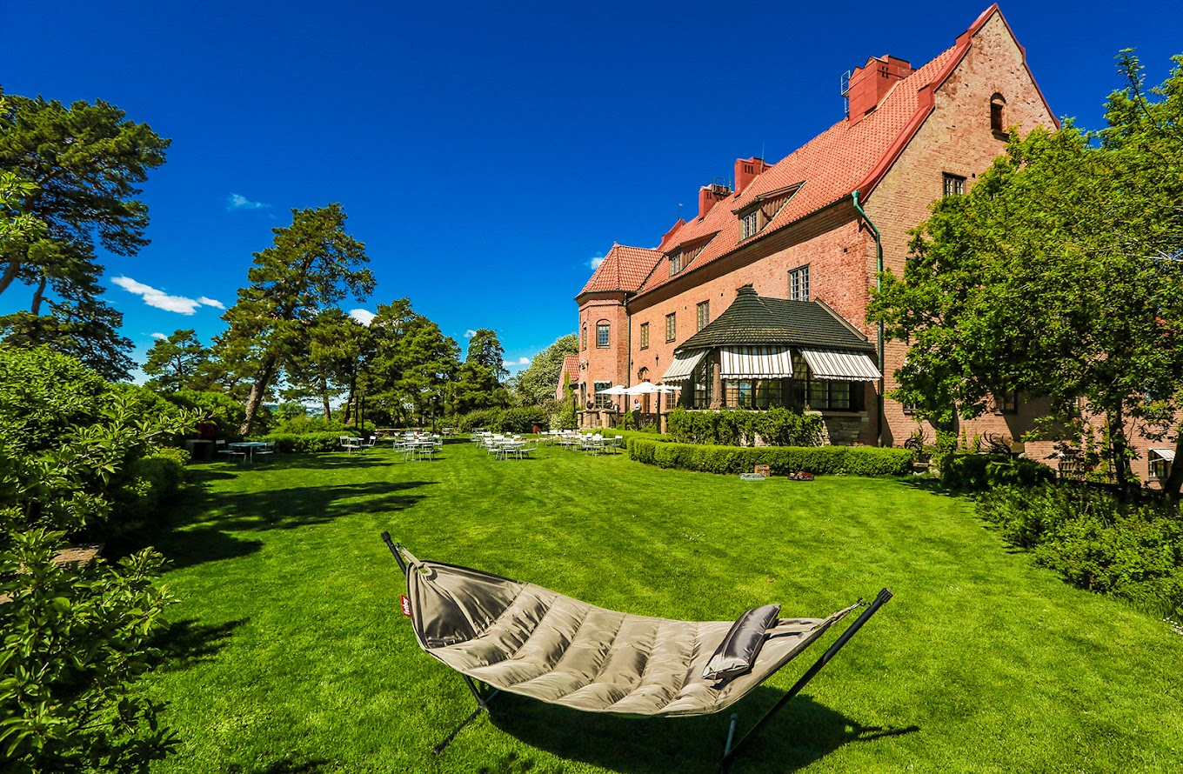
Nordic Masterclass on Epilepsy 2024
“The road to diagnosis in complex epilepsies”
This is the first meeting of the Nordic Masterclass in complex epilepsies in adults and children, welcoming a limited number of young physicians working with epilepsy from the Nordic countries. It is intended to be an annual training program aiming at fostering the next generation of epilepsy experts in the Nordic countries through interactive learning sessions. The meeting will be rotating between countries and is organised by an expert committee.
The 2024 Masterclass is entitled The Road to Diagnosis in Complex Epilepsies and focuses on the multidisciplinary workup including principles of genetic, metabolic, structural, and autoimmune investigations. The program is centered around case discussions in small groups and a semiology workshop.
Time and venue
September 19th-20th 2024, Högberga Gård outside Stockholm
Practicalities
Meeting participation including travel and accommodation is fully covered by the organization. The course in sponsored by Jazz Pharmaceuticals without influence over the agenda .
A maximum of 6 persons will be accepted from each country from Denmark, Finland, Norway and Sweden (with possible extra addition from Iceland).
Applicants should be physicians working in Epilepsy (adult and/or paediatric).
Application and selection of candidates is through national ILAE chapters.
Application opens March 11th and closes on April 21st , 2024.
Welcome to Stockholm and the Nordic Masterclass in Epilepsy
For questions, please contact your national representatives in the scientific committee or the local organizing committee at NordicMasterclassEP24@gmail.com

Slide 2
Program
Thursday Sept 19th
11.45 | Arrival and registration at Högberga Gård
12.00-13.00 | Lunch
13.00-13.15 | Welcome and intro to course program and faculty | Faculty
13.15-13.30 | Workup and diagnostics – role of the multidisciplinary team | Noemi Becser Andersen and Mette Thrane Foged
13.45-14.00 | The role of specific modalities in diagnosis | Noemi Becser Andersen and Mette Thrane Foged
14.00-14.15 | Aspects on diagnosing genetic epilepsies | TBA
14.20-14.40 | Aspects on diagnosing autoimmune epilepsies | Ronny Wickström
14.40-15.00 | Aspects on diagnosing metabolic epilepsies | TBA
15.00-15.30 | Coffee break
15.30 | Intro to 6 epilepsy case scenarios
15.40-16.30 | Discussions in 4 groups – Cases 1-3 | Faculty + participants
16.40-17.15 | Joint discussion of cases 1-3 | Moderator: Erik Tauböll and Christian Eckman
18.30 | Drinks and dinner
Friday Sept 20th
08.00-08.50 | Discussions in 5 groups – Cases 4-6 | Faculty + participants
09.00-09.30 | Joint discussion of cases 4-6 | Moderator: Reetta Kalviainen
09.30-10.00 | Coffee break
10.00-12.00 | Semiology workshop, part 1 | Sandor Beniczky
12.00-13.00 | Lunch
13.00-15.00 | Semiology workshop, part 2 | Sandor Beniczky
15.00-15.30 | Coffee break
15.30-16.30 | Wrapup and summary | Faculty
Organizing and scientific committee
Christian Eckmann (NO), Erik Tauboll (NO), Mette Thrane Foged (DEN), Noemi Becser Andersen (DEN), Katri Silvennoinen (FIN), Reetta Kalviainen (FIN), Karl Sallin (SWE) and Ronny Wickström (SWE)

